Slide 1
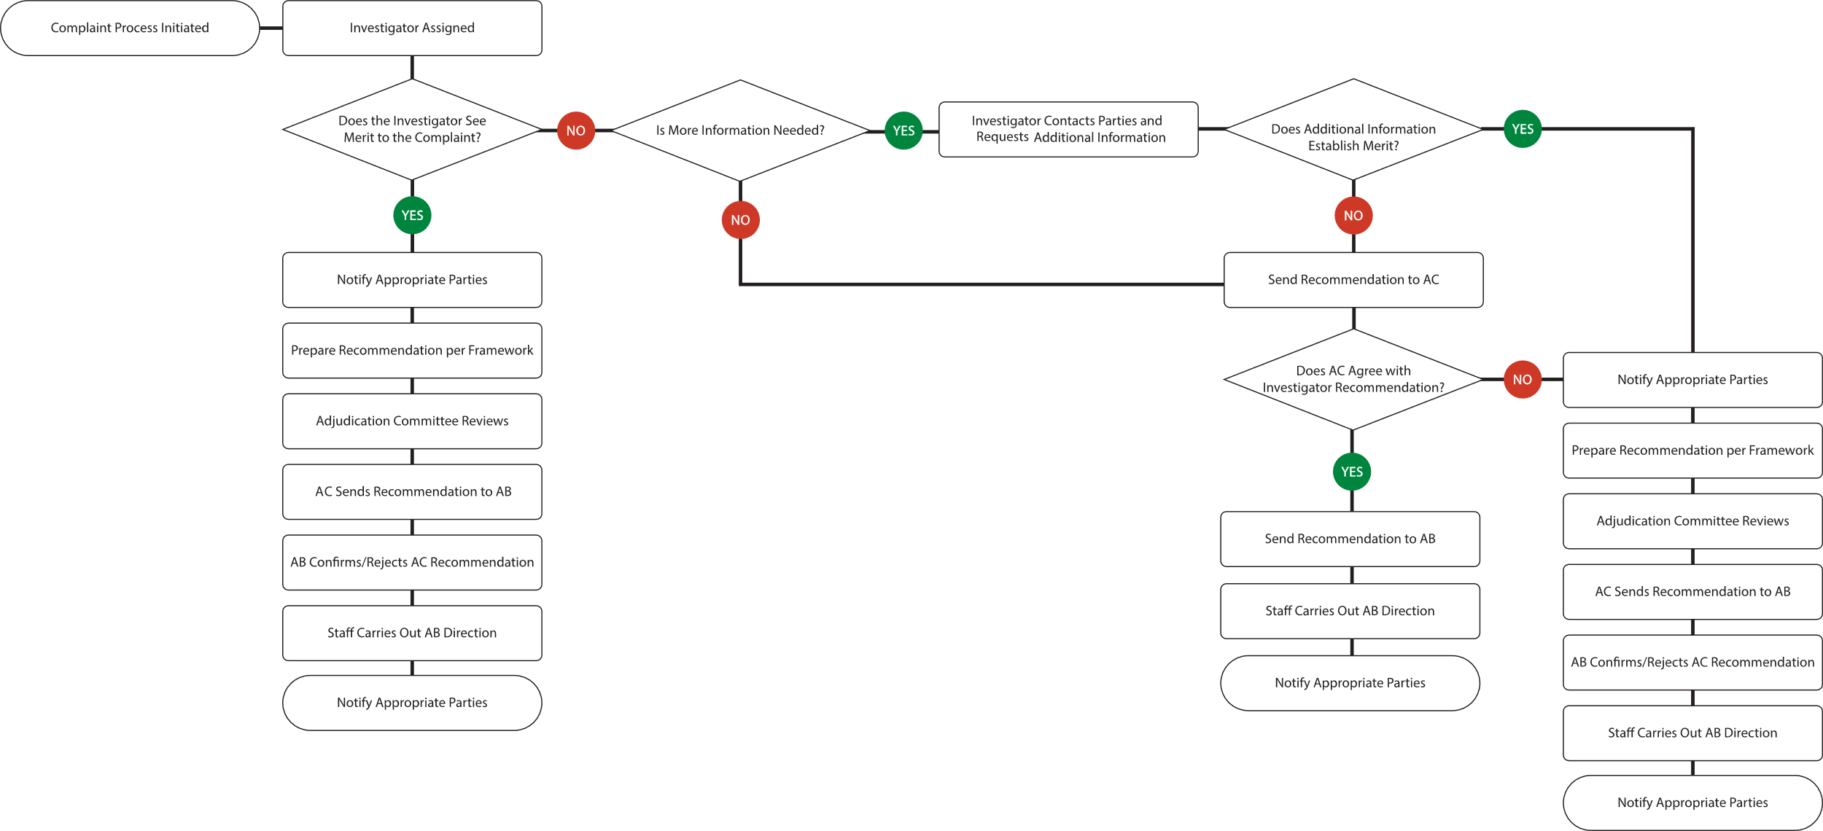
COMPLIANT PROCESS

Slide 2
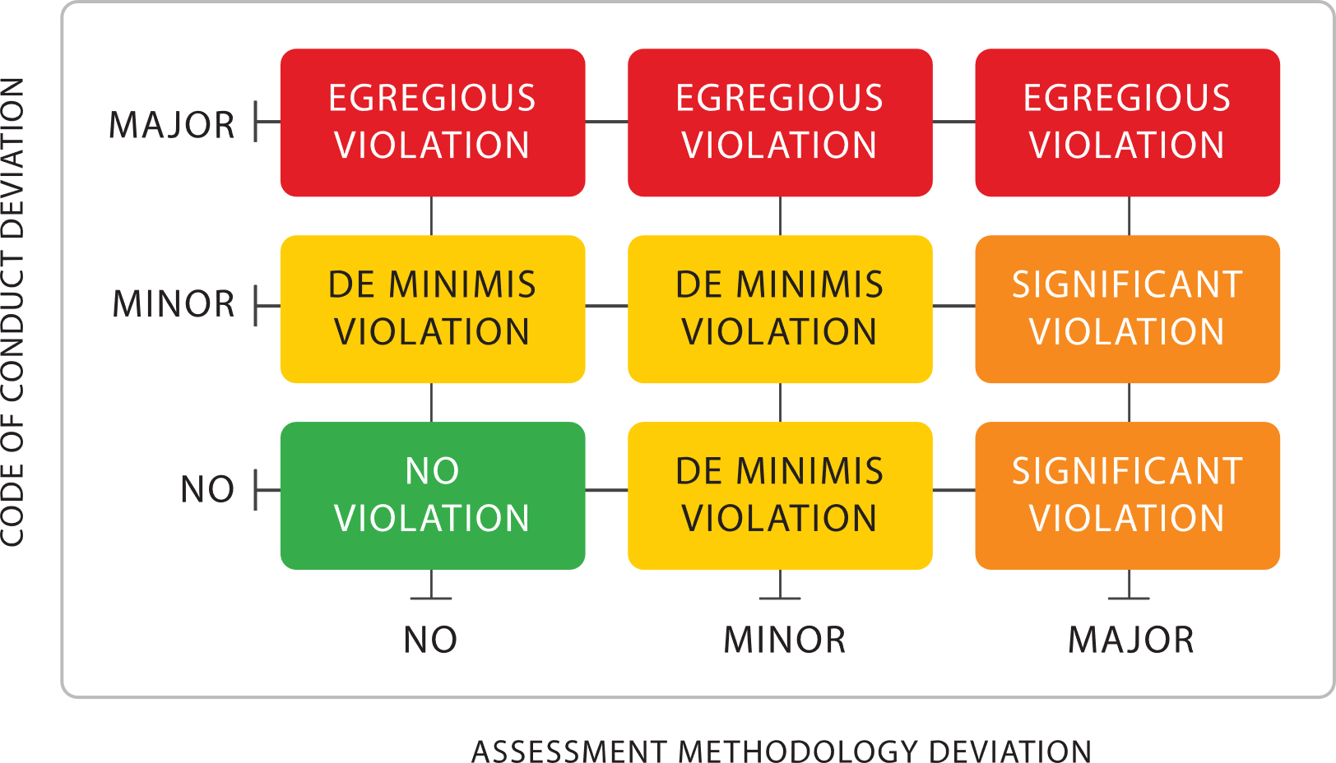
ADJUDICATION PROCESS - FRAMEWORK

